Slide 1


OBJECT DETECTION

Slide 2
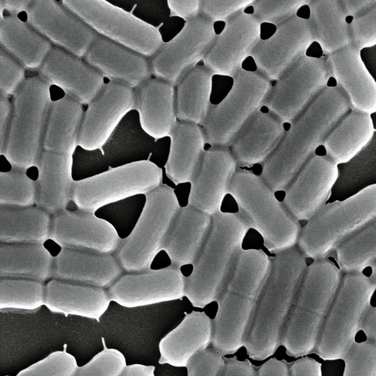
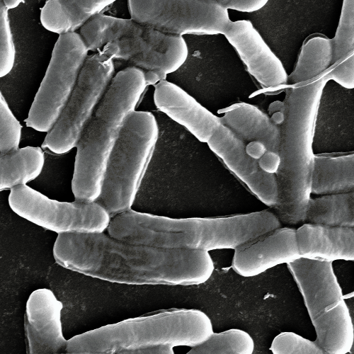


control
The project’s purpose:
Identification of bacterial cells under normal and acidic conditions from images.
acidic

Slide 3





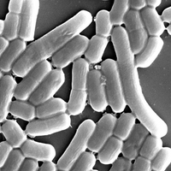
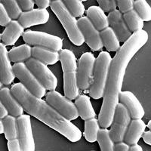
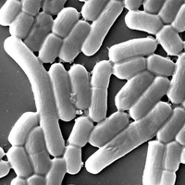

the process :
MICROSOFT VOTT
Image annotation tool and files export Export the labels in a CSV file
augmentations:
Creating augmentations for each image using Python code to increase the database
TENSOR-FLOW
An open source library for machine learning, developed by Google for building and training neural networks.Training the faster-R-CNN model on annotated images.
ROBOFLOW
Image annotation tool and files export. Converting a tagging file in CSV format to a COCO file

Slide 4
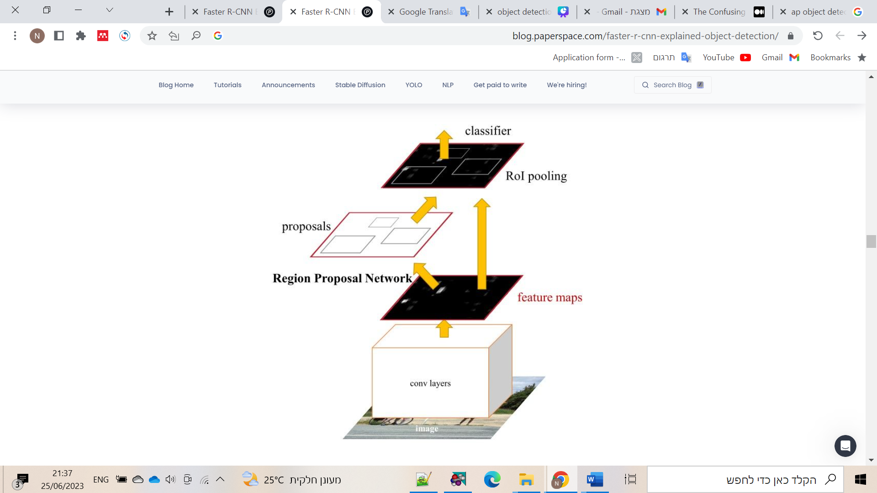
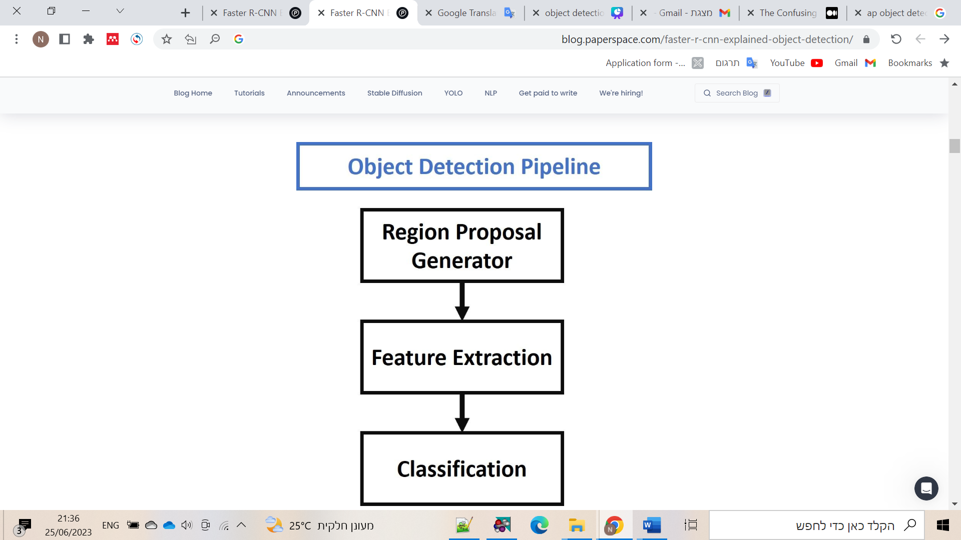
Faster R-CNN

Slide 5
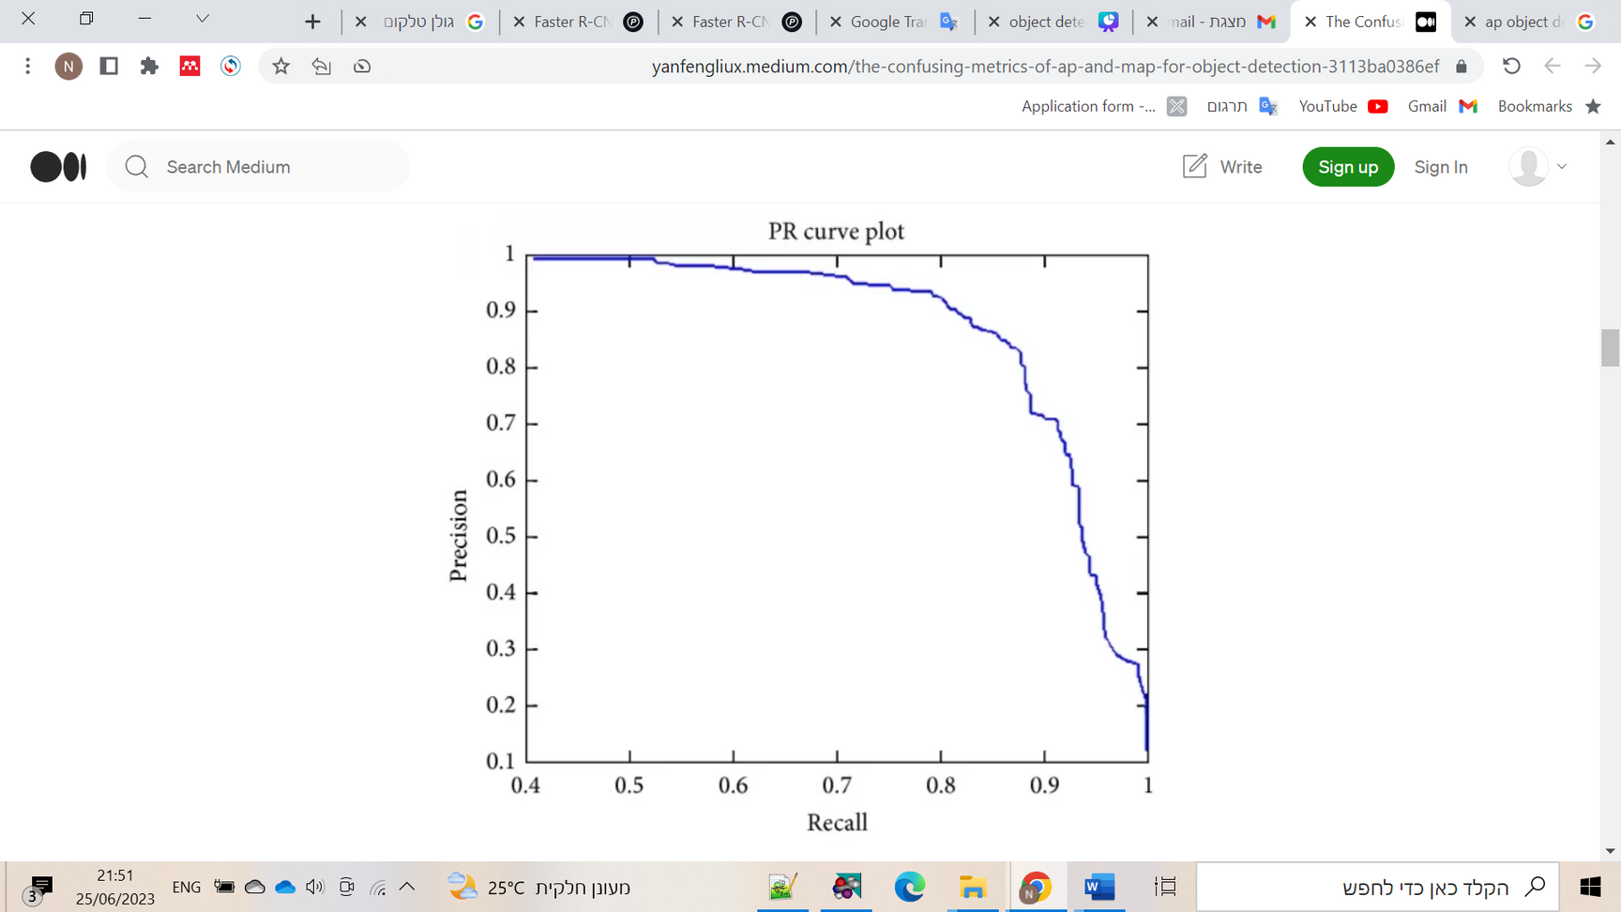
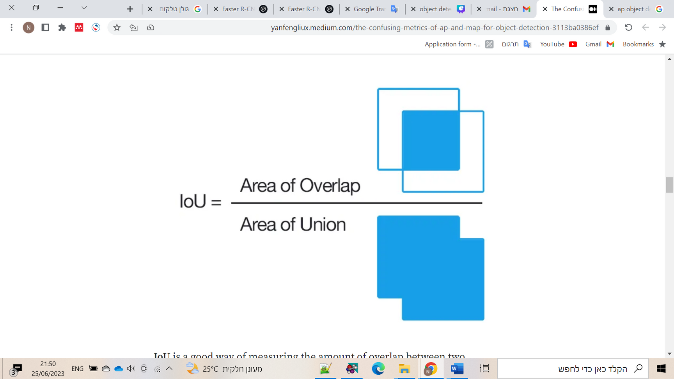
Evaluation
AP (Average Precision)
AP50
(based on Intersection-over-Union (IoU)

Slide 6
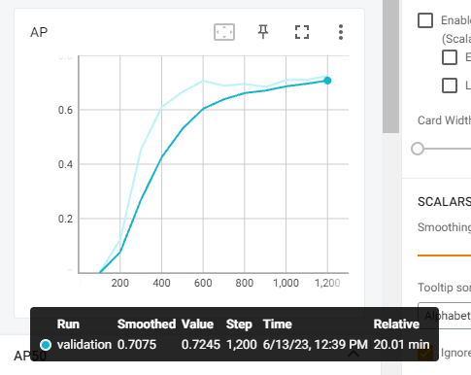
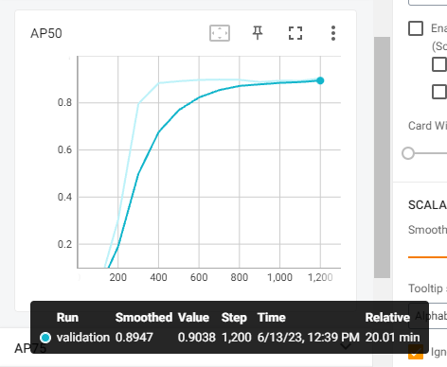
AP and AP50
results

Slide 7
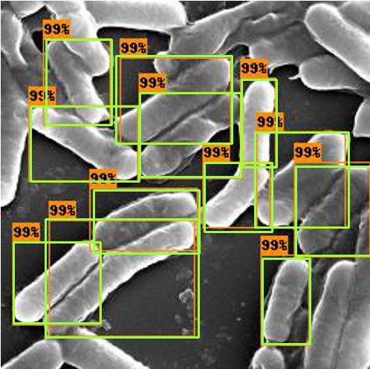
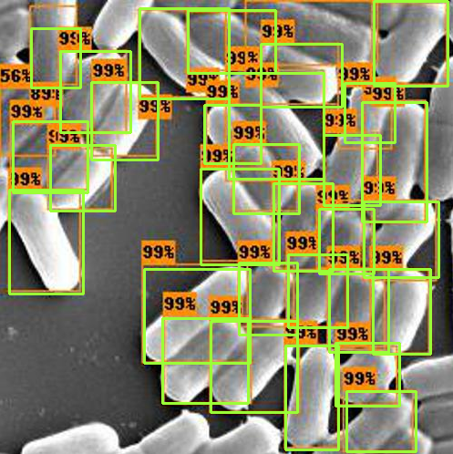
results

Slide 8

Thank you!
Bibiliography:
https://blog.paperspace.com/faster-r-cnn-explained-object-detection/
https://yanfengliux.medium.com/the-confusing-metrics-of-ap-and-map-for-object-detection-3113ba0386ef

